Slide 1



Tata AIA – Fan Posts
The information contained in the document is proprietary to Tata Industries Limited- Tata Insights & Quants Division and is strictly confidential. In consideration of receipt of this document, the recipient agrees that the information is being shared only for the limited purpose. The recipient of this information further agrees to maintain such information in confidence and to not reproduce, disclose, duplicate, electronically transmit or use in whole or in part for any other purpose. Prior written consent shall be obtained from the Insights & Quants Division of Tata Industries in case the information is necessitated to be shared with anyone other than the Recipient to whom this information is addressed. The above restriction shall not limit the right to use the information contained in this deck, if it is obtained from another source without restriction.
© Copyright, Tata Insights & Quants Division, Tata Industries Limited

Slide 2
Executive Summary
Methodology
Fan posts* of Tata AIA were analysed over Facebook** and Twitter from Jan – May 16 Posts were classified into various themes based on its content such as Website, Brand, Customer Service, Agents and Campaigns ‘Filtered word cloud’ was derived from ‘raw word clouds’ by removing and merging related keywords to drive insights
Trend of fan post in 2016 : March and April peak due to ‘Catchup’ Campaign
Key Observations
March & April witnessed exceptionally high number of Fan posts due to ‘Catchup’ Campaign Out of total 1145 Fan posts, Tata AIA had 39 % with Positive Sentiment and 8 % with Negative sentiment ‘Catchup’ campaign was responsible for most of Positive sentiment (Related to contest prize) and Neutral sentiment ( promotion & inquiry of contest) fan posts Negative Fan post were mostly related to customer service and alleged contact information leak of customers
Total
Total Fan Post | 42 | 20 | 284 | 740 | 59 | 1145
% Positive | 5 % | 25 % | 62 % | 33 % | 22 % | 39 %
% Negative | 50 % | 30 % | 7 % | 3 % | 31 % | 8 %
% Neutral | 45 % | 55 % | 31 % | 64 % | 47 % | 53 %
Channel Contribution
* Fan post are content posted by users on Tata AIA Social media profile
** ‘Visitor Posts ‘ on Facebook page of Tata AIA ( inbuilt forum at which people are free to raise their views and concerns) are captured . Specific comments to brand posts of Tata AIA on Facebook page could not be captured.

Slide 3

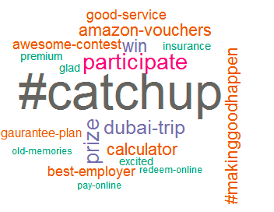
Tata AIA Fan Post – Positive Sentiment
Total Positive Posts | % of Positive Post | Time Period | Channels
443 | 39 % | Jan-May 2016 | Facebook & Twitter
Top Theme
Campaigns – Catchup
Raw Word Cloud
Filtered Word Cloud
Observations
Campaign : Most discussions were around Amazon vouchers and Dubai as a holiday destinations for ‘CatchUp’ campaign winners
Brand : regarding Tata AIA awarded as one of Best employers
Theme distribution

Slide 4
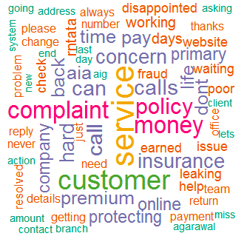
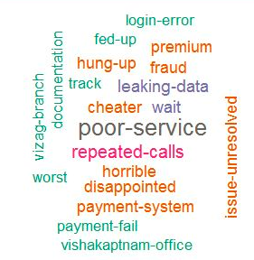
Tata AIA Fan Post – Negative Sentiment
Total Negative Posts | % of Negative Post | Time Period | Channels
88 | 8 % | Jan-May 2016 | Facebook & Twitter
Top Theme
Customer Service
Raw Word Cloud
Filtered Word Cloud
Observations
Customer Service : Mostly related to delayed response as a complain by users
Brand & Others : Most users were concerned with data breach related to their contact information and harassment call by fake agents
Website : Few users were concerned with failure to pay premium online
Others : Issue related to selling policy to advisors (new recruits) was raised for Vizag Branch
Theme distribution

Slide 5

Thanks

